Slide 1

Training / Q&A
Session 2

Slide 2
Today’s Training
Recap of Services We Provide
Refund Policy
Selling Tools Demo(s)
CRM Demo
Commission/Bonus Recap
Teen to show how to configure G-Voice number settings
Mobile Mockup Tool
Mobile Simulator
IsMySiteAtRisk.com
RepVerification.com
CRM
Website updated – Samples / Sales Agents / Agreements/etc
Sales Manager – What we need next

Slide 3
Recap – Services We Provide
Websites
Mobile Websites
WordPress Security
Reputation Marketing
Coming Soon
  Contractor Software
  Facebook Pages
  Mobile Apps
  Coupons & Incentives
  Landing Pages

Slide 4
Unbelievable Mobile Stats
Over 50% of all local searches are done on a mobile device
86% of mobile Internet users are on their device when watching TV
29% are open to scanning a mobile QR Code to get discounts
32% of all Internet searches are done on smart phones
There are more text messages sent than calls completed
There are more mobile devices than autos and credit cards
On average, users spend 2.7 hours a day socializing on their mobile device
39% use the Internet on their smartphones while going to the bathroom
70% have used their smartphones while shopping in-store
88% of people looking for local information have taken action within a day.
82% of smartphone users notice mobile ads

Slide 5
Websites
40% of businesses in the US still do not have a website!
Samples of websites we do –
  http://mobilewebmds.com/websites
  http://mobilewebmds.com/website-samples
Commission on a website sale?
$249.70

Slide 6
Mobile Websites
90%+ of businesses in the U.S. DO NOT have a mobile site
We provide you tools to help you sell these
  Mobile Website Simulator
  Mobile Mockup Creator
Commission on a Mobile Website sale?
$99.70

Slide 7
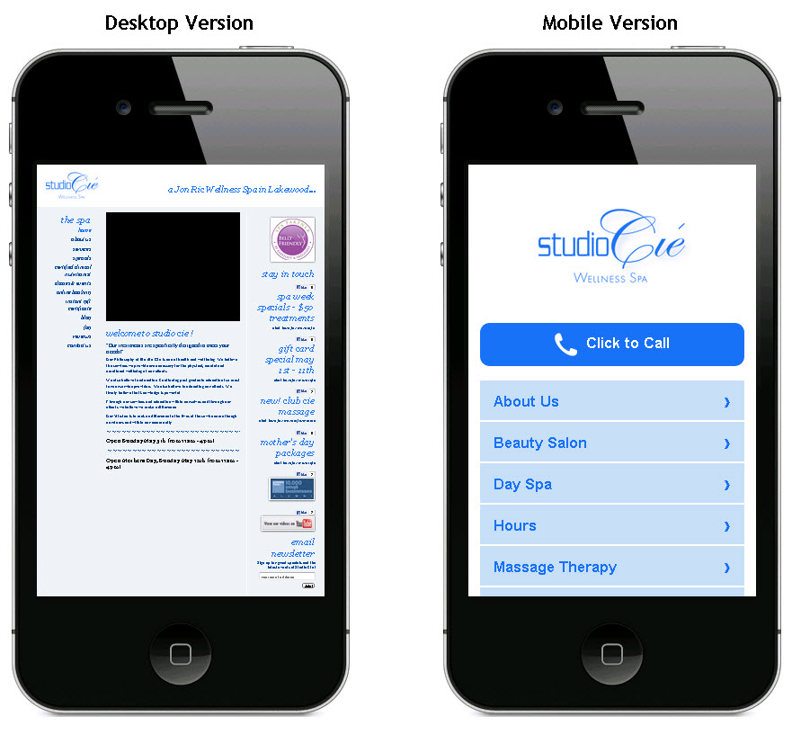
Mobile Websites
Here is a regular website compared to a mobile website:

Slide 8
WordPress Security
There are tons of sites that are vulnerable
There are 8 tests that we do to check a site
We provide a tool to help you sell
  IsMySiteAtRisk.com to test a companies website
Commission on a WordPress Security sale?
$29.70

Slide 9
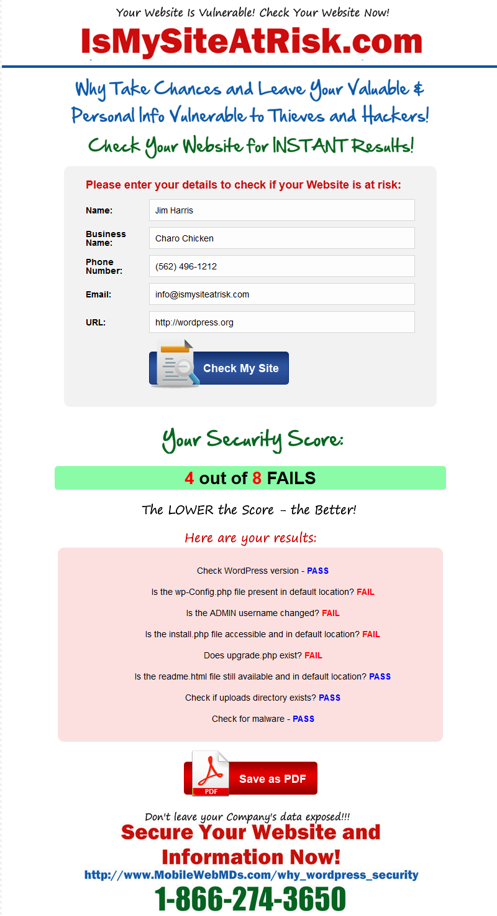

Slide 10
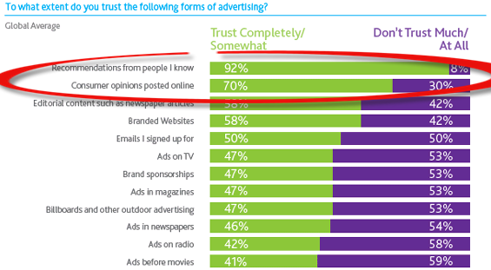
Reputation Marketing
70% of Consumers trust Online Reviews
If a Business has Negative Reviews –
They are losing Customers and Money

Slide 11
Reputation Marketing
We help businesses build a 5 Star Reputation
We target businesses that have Negative online reviews
We provide a tool to help you sell
  Repverification.com – shows BAD reviews
Commission on a Reputation Marketing sale?
$249.70

Slide 12
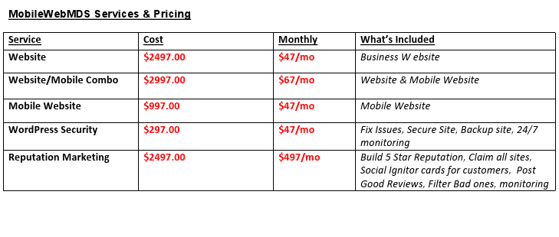
Cheat Sheet – Current Services

Slide 13
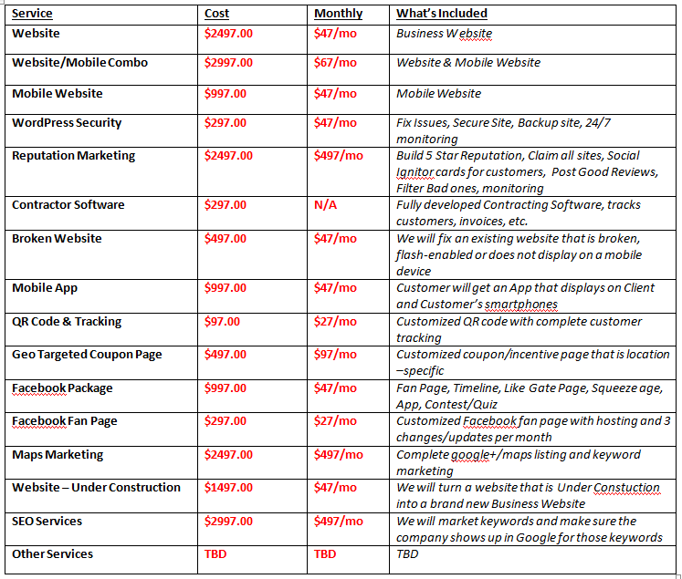
Cheat Sheet for All Services

Slide 14
Refund Policy
"For my Services, I don't offer a refund. I can't get my time back. So, you can't get your money back. If you find a way to get my time back, e-mail me and I'll consider changing my refund policy."
No refund but we will Work with our customers until they are 100% happy with their service.

Slide 15
Refunds
With the exception of Web Design services our services are non-refundable. Because we provide soft services (not tangible products), all sales are final.
Web Design Contract Cancellation.
A non-refundable deposit amount of 50% is due at the time of the contract signing. If 100% of payment was made upfront, then 50% of that payment will be refunded back to the customer minus the amount already incurred in the development of the project by the date of cancellation, based on the amount of $60/hour. Cancellation of any web design project by either party will result in a refund to the client of all fees paid beyond the deposit amount, minus the amount already incurred in the development of the project by the date of cancellation, based on the amount of $60/hour. Web design cancellation refunds will be processed and delivered within 10 business days of the cancellation date.

Slide 16
Refund policy
Only state the policy if someone asks
We don’t want to advertise it
If you notice that you are losing sales because of the current Refund policy we can change it
Let your Sales Manager know

Slide 17
Other Services
Other services will become available over the next few months
  Contractor Software
  Facebook Pages
  Mobile Apps
  Coupons & Incentives
  Landing Pages
Once you sell ONE Service to a client, it’s much easier to upsell additional Services to them

Slide 18
Training and Support
Everything you need is available on the website
Resources section with tons of information to help you understand the process of each service, Calling Scripts, Statistics, etc.
How to documentation for everything you need
Work with your Sales Manager
Even if your Sales Manager closes the sale you still get your commission!

Slide 19
Commissions
You are eligible for a commission once we receive at least 50% of the payment
We encourage you to try to get 100% of the payment up front
If not, we need 50% of the payment to start the work, and the other 50% upon completion
Commissions are paid via PayPal

Slide 20
Bonuses
10% flat commission: 1-7 sales
15% for next 8-10 sales (10th sale = $150 bonus)
20% 11-14 sales
25% sales #15 and up (15th sale = $1000 bonus)
Sales Bonuses
10th sale = $150
15th sale = $1000
30th sale = $2500
*For the month, after 30 days all commissions reset back to 10%

Slide 21
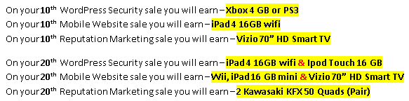
Prize Bonuses
In addition to Commission Bonuses, Sales Agents are also eligible for Prize Bonuses

Slide 22
Demos
Teen to show how to configure G-Voice number settings
Mobile Mockup Tool
Mobile Simulator
IsMySiteAtRisk.com
RepVerification.com
CRM
Website updated – Samples / Sales Agents / Agreements/ etc

Slide 23
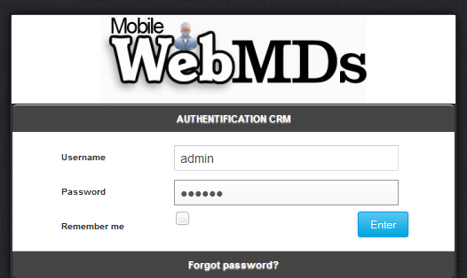
CRM
The CRM is a Customer Relations Mgmt system
Everyone will have a Username and Password
Everything is tracked in the CRM

Slide 24
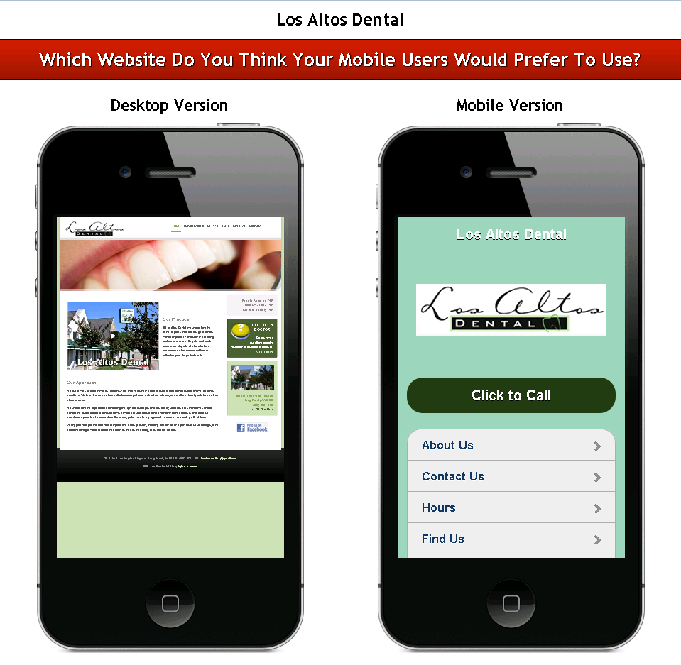
Selling Tools – Mobile Mockup

Slide 25
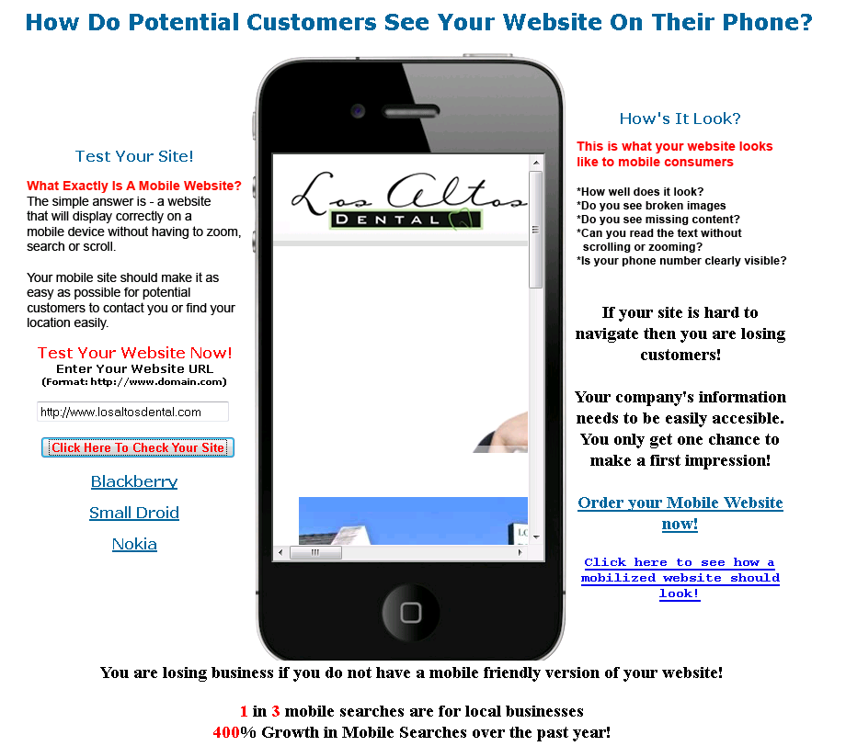
Selling Tools – Mobile Simulator

Slide 26
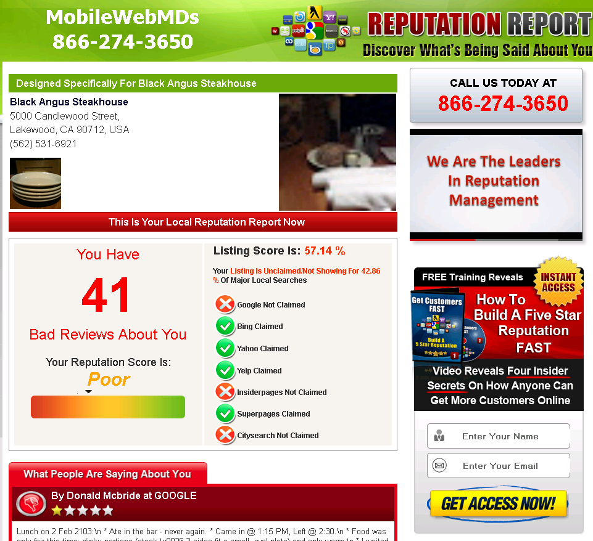
Selling Tools – RepVerification.com

Slide 27
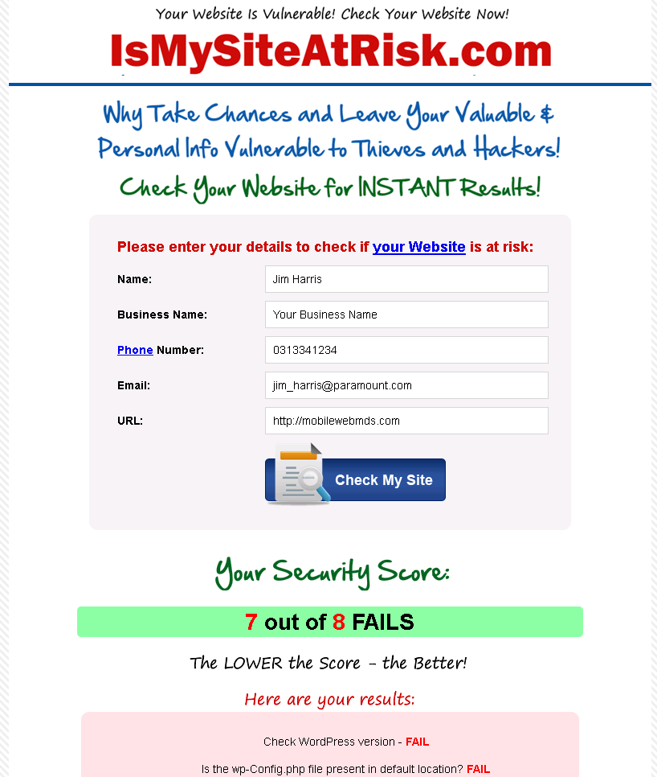
Selling Tools – IsMySiteAtRisk.com

Slide 28
Launch Date
Go live Monday May 6th!
Skype, Paypal, Docs
Welcome email coming this week with login info, CRM, etc.

Slide 29
Questions?

