Slide 1

Training / Q&A
Session 1

Slide 2
What Services Do We Provide?
Websites
Mobile Websites
WordPress Security
Reputation Marketing
Coming Soon
  Contractor Software
  Facebook Pages
  Mobile Apps
  Coupons & Incentives
  Landing Pages

Slide 3
Websites
Every company needs a website
40% of businesses in the U.S. DO NOT have a website
You will have unlimited leads of companies that do not currently have a website
Show them the benefits of having a website and make the sale
Commission on a website sale?
$249.70

Slide 4
Mobile Websites
By the end of 2013, there will be more mobile devices on Earth than people
4 out of 5 consumers use smartphones to shop
90% look up local information; 87% of these users subsequently call the business, visit the website or store, make a purchase, or get directions to the business
90%+ of businesses in the U.S. DO NOT have a mobile site

Slide 5
Mobile Websites
If a company does not have a mobile website, it is costing them money
You will have access to unlimited leads of companies that do not have a mobile website
We provide you tools to help you sell these
  Mobile Website Simulator
  Mobile Mockup Creator
Commission on a Mobile Website sale?
$99.70

Slide 6
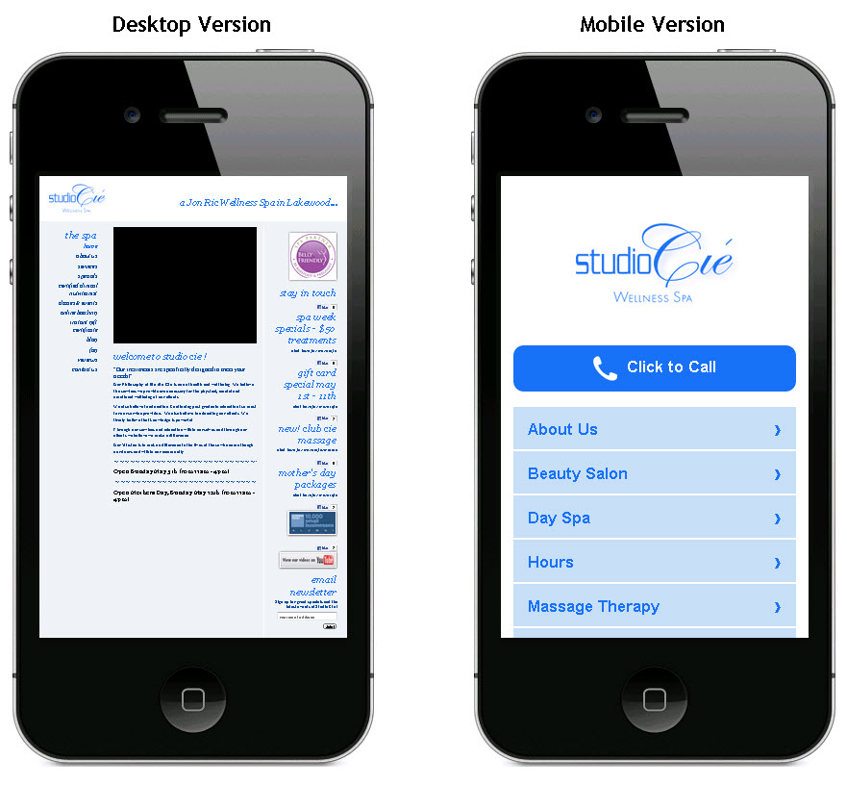
Mobile Websites
Here is a regular website compared to a mobile website:

Slide 7
WordPress Security
20-30% of the websites in the world use WordPress
WordPress has vulnerabilities out of the box
95% of these websites are vulnerable
There are 8 tests that we do to check a site
We provide a tool to help you sell
  IsMySiteAtRisk.com to test a companies website
You have access to unlimited leads of websites with vulnerabilities
Commission on a WordPress Security sale?
$29.70

Slide 8
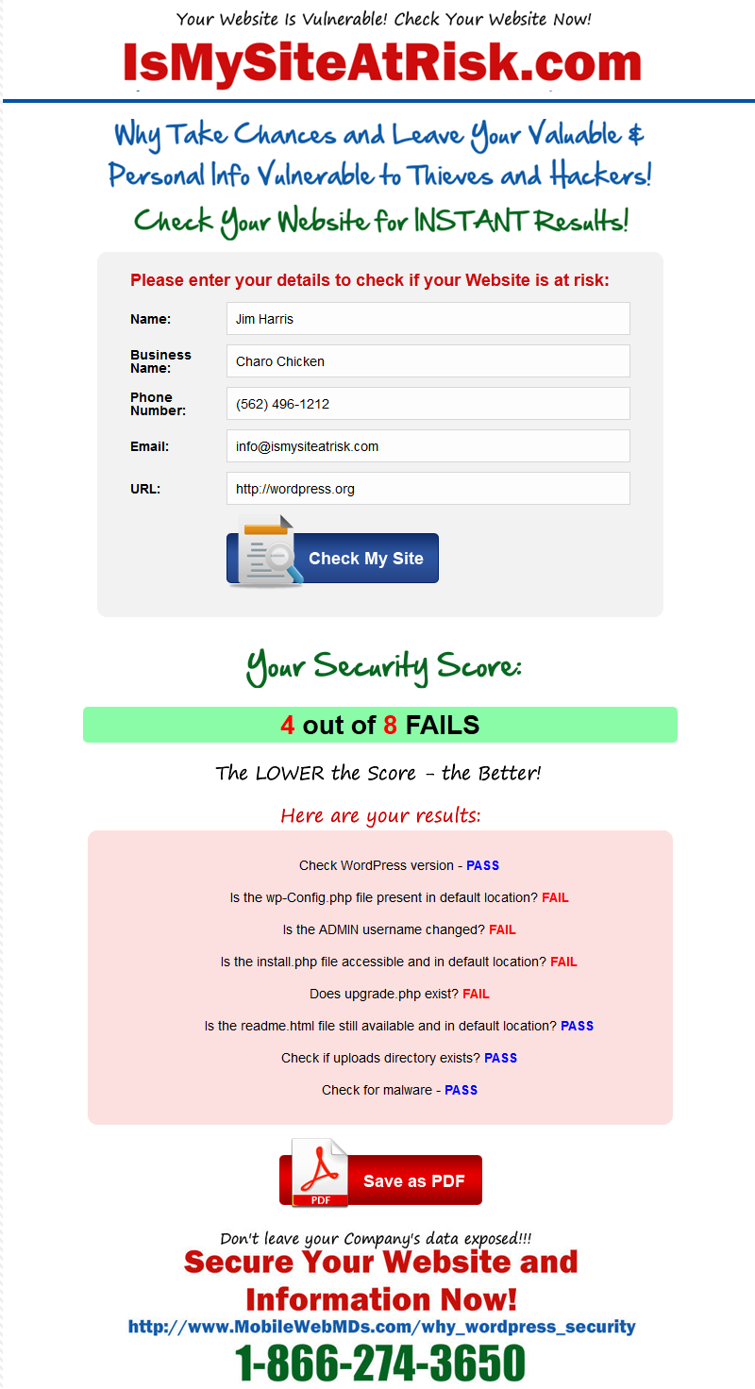

Slide 9
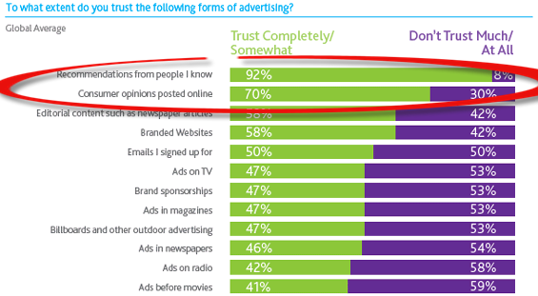
Reputation Marketing
70% of Consumers trust Online Reviews
If a Business has Negative Reviews –
They are losing Customers and Money

Slide 10
Reputation Marketing
We help businesses build a 5 Star Reputation
We target businesses that have Negative online reviews
We provide a tool to help you sell
  Repverification.com – shows BAD reviews
You will have access to unlimited leads of businesses that have BAD online reviews
Commission on a Reputation Marketing sale?
$249.70

Slide 11
Other Services
Other services will become available over the next few months
  Contractor Software
  Facebook Pages
  Mobile Apps
  Coupons & Incentives
  Landing Pages
Once you sell ONE Service to a client, it’s much easier to upsell additional Services to them

Slide 12
Training and Support
Everything you need is available on the website
Resources section with tons of information to help you understand the process of each service, Calling Scripts, Statistics, etc.
How to documentation for everything you need
Work with your Sales Manager
Even if your Sales Manager closes the sale you still get your commission!

Slide 13
Commissions
You are eligible for a commission once we receive at least 50% of the payment
We encourage you to try to get 100% of the payment up front
If not, we need 50% of the payment to start the work, and the other 50% upon completion
Commissions are paid via PayPal

Slide 14
Bonuses
10% flat commission: 1-7 sales
15% for next 8-10 sales (10th sale = $150 bonus)
20% 11-14 sales
25% sales #15 and up (15th sale = $1000 bonus)
Sales Bonuses
10th sale = $150
15th sale = $1000
30th sale = $2500
*For the month, after 30 days all commissions reset back to 10%

Slide 15
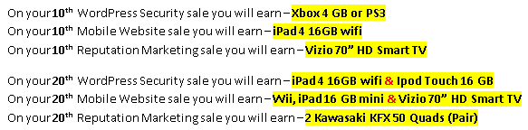
Prize Bonuses
In addition to Commission Bonuses, Sales Agents are also eligible for Prize Bonuses

Slide 16
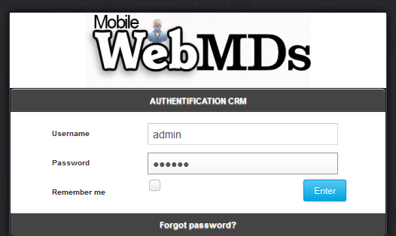
CRM
The CRM is a Customer Relations Mgmt system
Everyone will have a Username and Password
Everything is tracked in the CRM

Slide 17
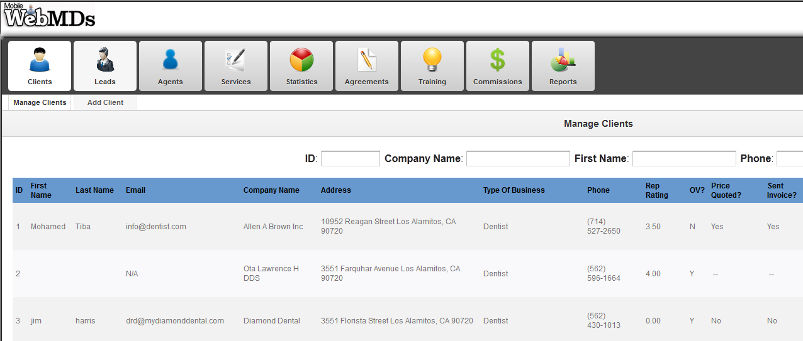
CRM

Slide 18
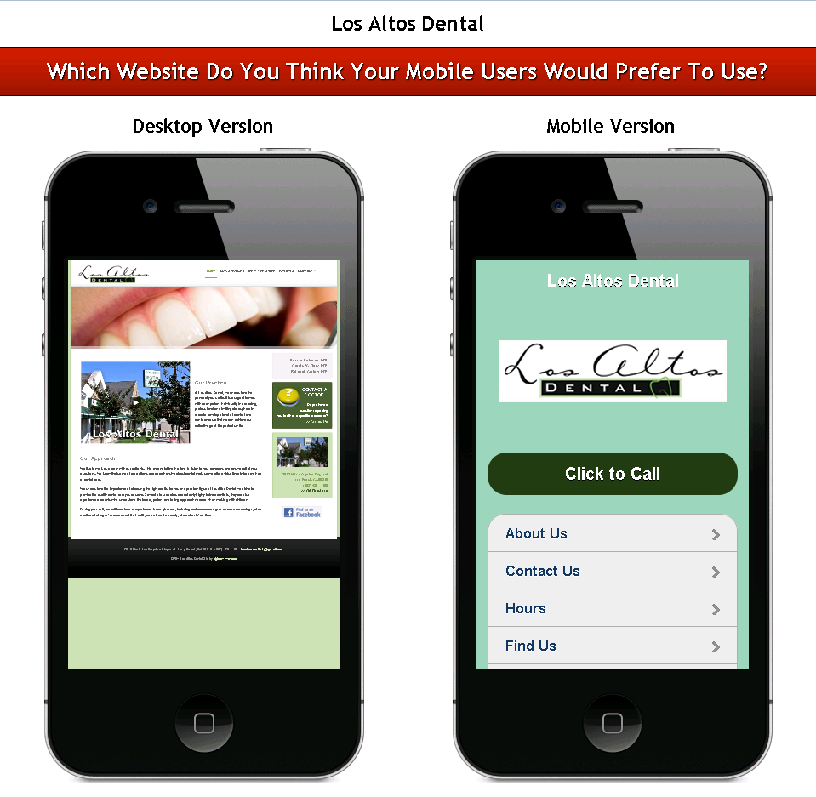
Selling Tools – Mobile Mockup

Slide 19
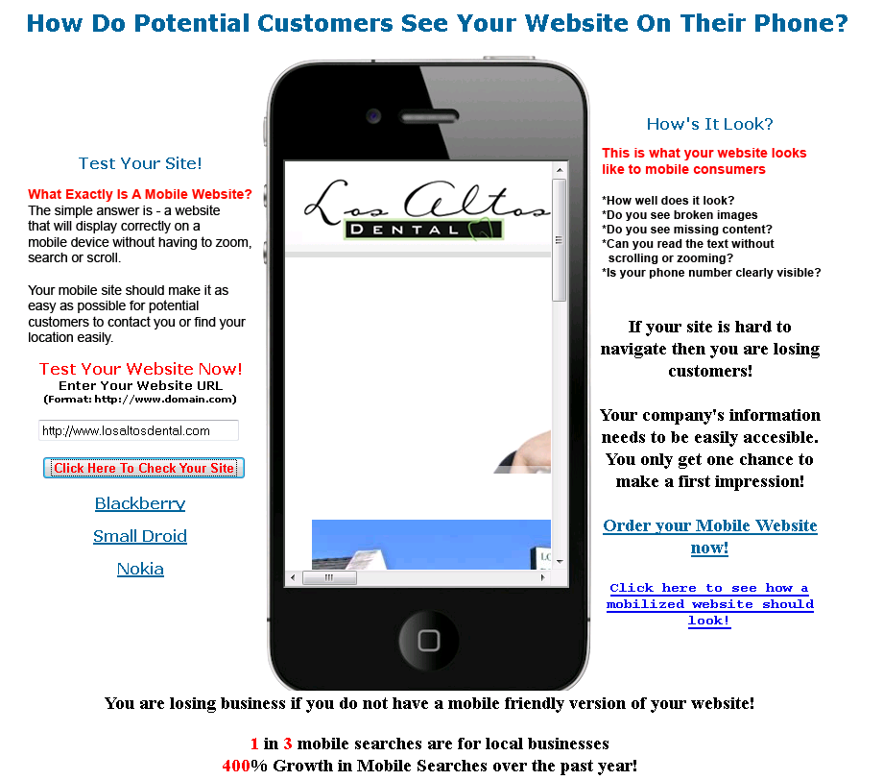
Selling Tools – Mobile Simulator

Slide 20
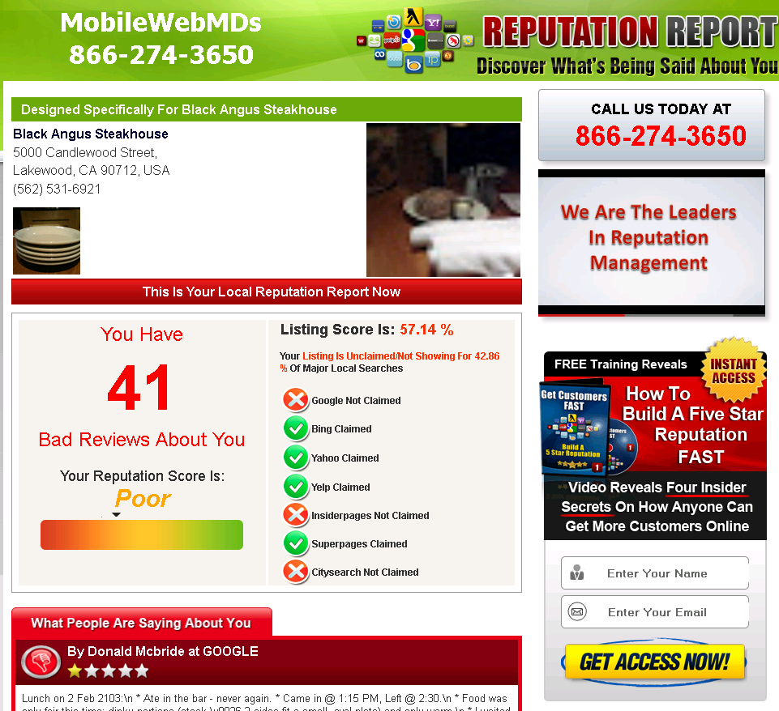
Selling Tools – RepVerification.com

Slide 21
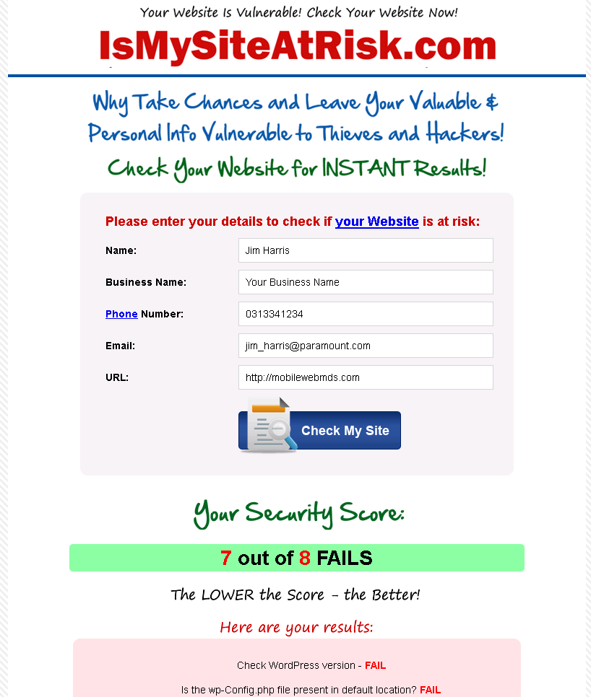
Selling Tools – IsMySiteAtRisk.com

Slide 22
Requirements
Computer
Microsoft Outlook
Paypal Account (it’s free)
A phone/cell phone with free long distance
Skype Account (it’s free)

Slide 23
Starting Out
You will receive:
Your own email address
Your own phone number for voicemails
Access to the CRM
Access to all of the Selling Tools
Access to the Resources section
    http://www.MobileWebMDS.com/resources
Work with your Sales Manager
    john@mobilewebmds.com
Training session in next 2 weeks (SellingTools)
Official launch
May 6, 2013

Slide 24
Questions?

